Slide 1
Food Demand Forecasting
Hussain Kaide Johar Manasi
April 25th, 2024
Notes:
Thao

Slide 2

Agenda:
Data Pre-processing & Exploratory analysis
Results and Evaluation
Problem Statement and Objective
Algorithms, Analysis, and Implementations
Conclusions
Notes:
Charanya

Slide 3
Problem Statement and Objective

Slide 4
Problem Statement
The meal delivery service industry relies heavily on accurate demand forecasting to optimize inventory management and ensure timely delivery to customers. In this context, optimizing and accurately predicting the number of orders in the upcoming weeks based on historical data from three primary datasets: Meals Info, Fulfillment Center, and Sales Dataset.
Objective
The primary objective is to develop predictive models capable of accurately forecasting the number of orders for each meal and fulfillment center combination in the upcoming weeks. By leveraging historical data and advanced analytics techniques, I aim to optimize inventory levels, streamline operations, and enhance customer satisfaction.
Notes:
Thao

Slide 5
Dataset Overview
Meals Info: This dataset contains information about meal categories and cuisine details, categorizing meals into various types such as Thai, Indian, and others. (51, 3)
Columns: ['meal_id', 'category', 'cuisine']
Fulfillment Center: Details of the fulfillment centers where meals are stored and dispatched, providing crucial information on logistics and distribution channels. (77, 5)
Columns: ['center_id', 'city_code', 'region_code', 'center_type', 'op_area']
Sales Dataset: Historical data detailing the number of orders for each meal from each fulfillment center, along with associated attributes such as base price, checkout price, etc. Each transaction is assigned to one of 150 weeks, providing a temporal context for analysis. (456548, 21)
Columns: ['id', 'week', 'center_id', 'meal_id', 'checkout_price', 'base_price’, 'emailer_for_promotion', 'homepage_featured', 'num_orders’
Source: https://www.kaggle.com/datasets/kannanaikkal/food-demand-forecasting/data

Slide 6
Data Preprocessing and Exploratory Analysis

Slide 7
Feature Engineering
In order to enrich the dataset and capture additional insights, I performed feature engineering on the available attributes. The following features were created:
Discount Amount and Percentage:
Utilizing the base price and checkout price information from the Train Dataset, calculated the discount amount and percentage for each transaction. These features provide insights into promotional activities and pricing strategies that may influence order volume.
Quarters:
Derived a new feature representing the quarter of the year in which each transaction occurred. This allows us to analyze seasonal variations in order patterns and tailor predictive models accordingly.
Notes:
Thao

Slide 8
Data Preprocessing
Before proceeding with model development, I conducted extensive data preprocessing to ensure the quality and consistency of the dataset. The following steps were undertaken:
One-Hot Encoding:
Categorical variables such as cities in the Fulfillment Center dataset, center_id, meal_id, and region_codes were one-hot encoded. This transformation converts categorical variables into binary vectors, facilitating their incorporation into machine learning algorithms.
Normalization:
To standardize numerical features and ensure uniformity in scale, applied the StandardScaler to the relevant attributes in the dataset. This normalization technique helps prevent certain features from dominating others during model training.
Handling Outliers:
Outliers in numerical features, such as base price and checkout price, were addressed using log transformations. By applying logarithmic transformations, mitigate the impact of extreme values while preserving the overall distribution of the data.

Slide 9
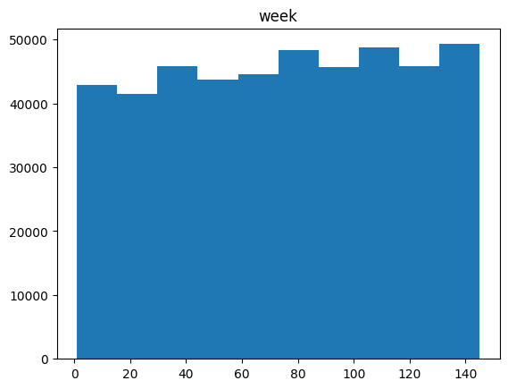
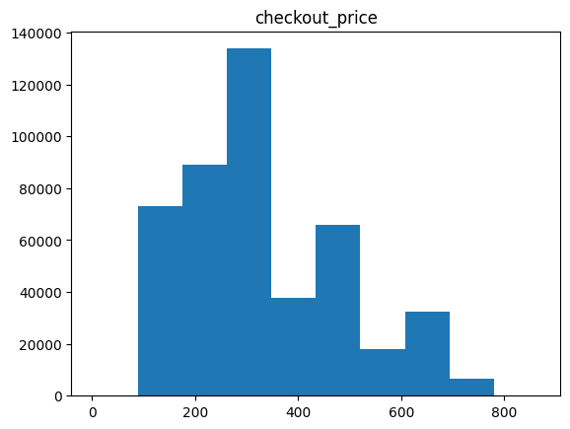
Histograms of weeks, and checkout prices

Slide 10
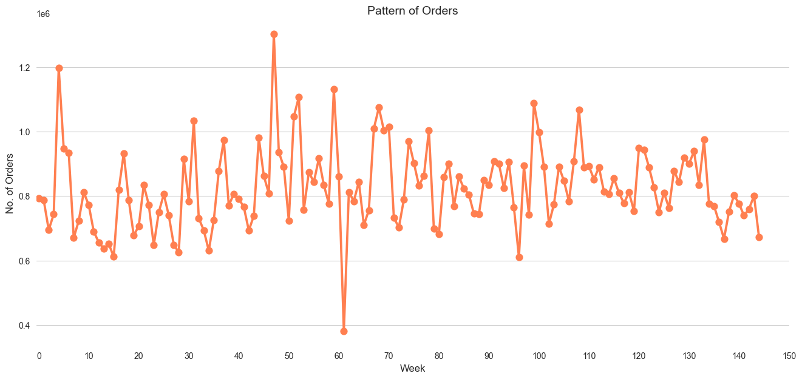
Line plot of orders over time

Slide 11
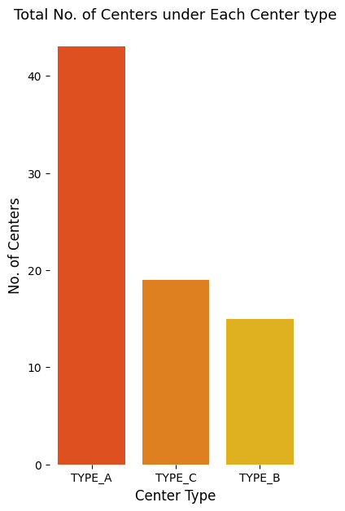
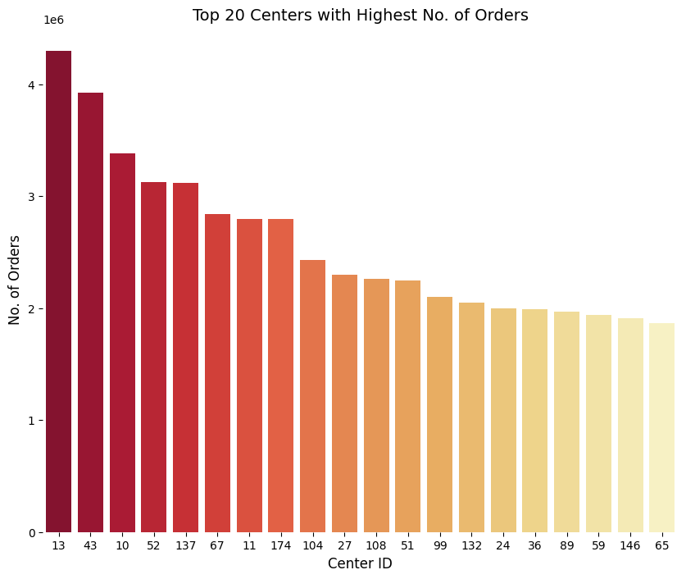
About the Centers

Slide 12
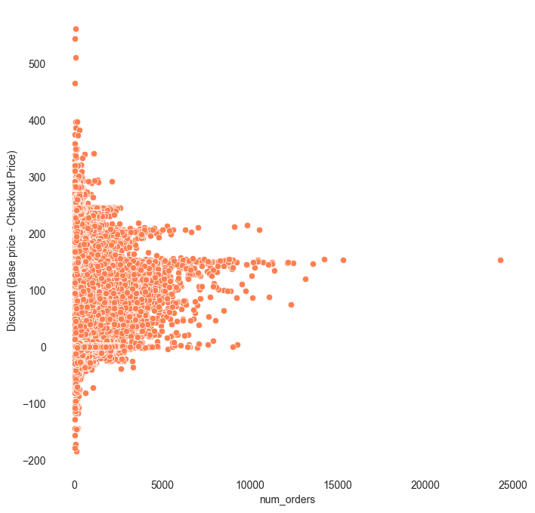
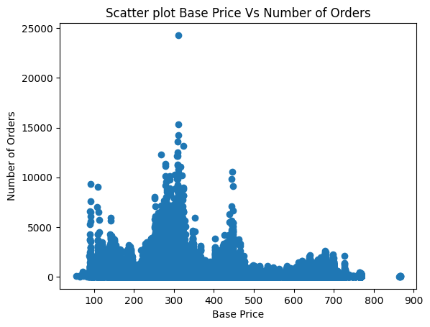
About the prices

Slide 13
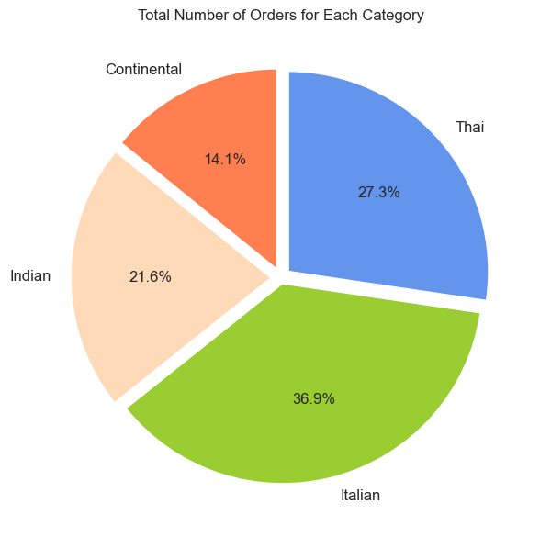
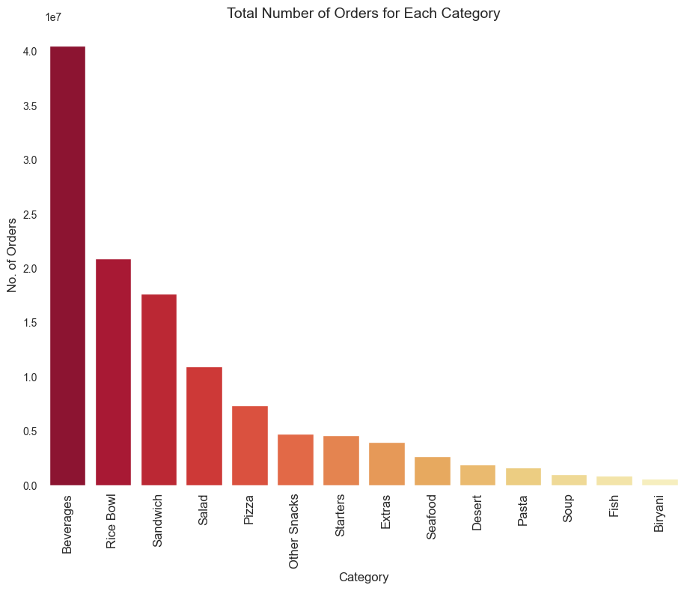
About the Orders

Slide 14
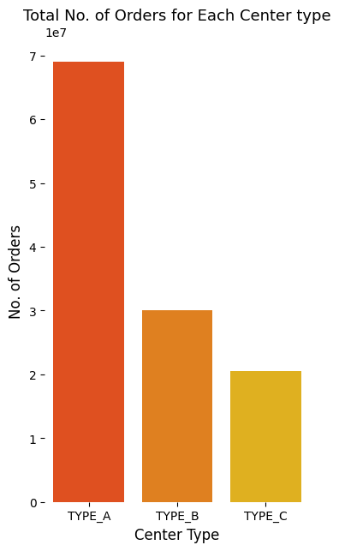
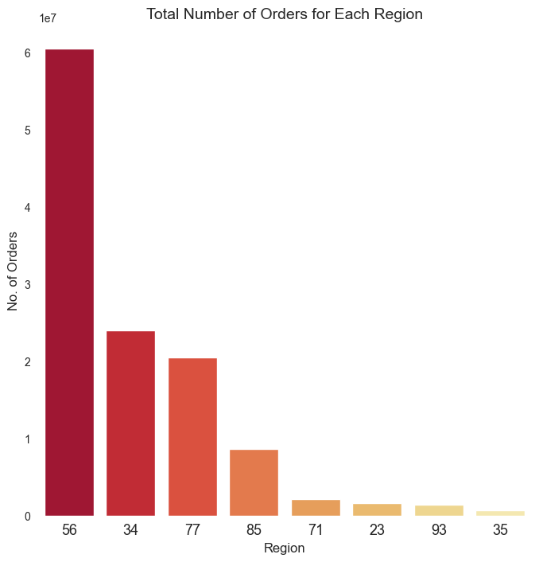
Orders and Centers

Slide 15
Models Used

Slide 16
List of Models Used
Linear Regression
Decision Tree
KNN Regressor
Ridge and Lasso Regression
Random Forest Regressor
CatBoost
XGBoost Regressor
LightGBM
Notes:
Thao

Slide 17
Results and Evaluation

Slide 18
Results
Model | MAE | MSE | R2
Linear Regression | 0.494 | 0.390 | 0.704
Decision Tree | 0.534 | 0.462 | 0.649
KNN Regressor | 0.428 | 0.314 | 0.762
Ridge and Lasso Regression | 0.494 0.562 | 0.390 / 0.498 | 0.704 / 0.622
Random Forest Regressor | 0.522 | 0.438 | 0.668
CatBoost | 0.381 | 0.247 | 0.812
XGBoost Regressor | 0.393 | 0.260 | 0.802
LightGBM | 0.392 | 0.257 | 0.804

Slide 19
Conclusions

Slide 20
Takeaways
The project successfully developed and evaluated multiple predictive models, with CatBoost emerging as the top performer, achieving an impressive R2 of 0.812.
Through extensive data preprocessing, feature engineering, and model experimentation, I optimized the prediction accuracy and robustness of the models.
The utilization of advanced machine learning techniques such as CatBoost demonstrates the effectiveness of leveraging state-of-the-art algorithms for demand forecasting in the meal delivery industry.
Business Impact
Accurate order prediction enables the meal delivery service to optimize inventory management and ensure sufficient stock levels to meet customer demand, reducing the risk of overstocking or stockouts.
Enhanced operational efficiency through improved demand forecasting allows for better resource allocation, minimizing wastage and maximizing cost-effectiveness.
The ability to predict future order volumes with high accuracy empowers the meal delivery service to plan marketing campaigns, promotions, and menu offerings strategically, aligning with customer preferences and seasonal trends.
Ultimately, the implementation of advanced predictive modeling techniques like CatBoost translates into improved customer satisfaction, increased revenue, and sustainable growth for the meal delivery business.
Notes:
Thao

Slide 21
THANK YOU!

